Slide 1
Cloud @ eBay From ground level to clouds
JC Martin Cloud Architect, eBay Marketplace
@jchmartin

Slide 2
Quiz
Number of App Servers:
More than 100,000
10 big ones
Around 6,000
Number of active users
Population of the Philippines (~94M)
Population of China (~ 1.3B)
Population of Mendocino, CA (800)
1 second of downtime
$5 lost
$2,000 lost
$2,000,000 lost
Best Company to work for
eBay

Slide 3
What is eBay.com
Data Analytics
Search
Front End
2
200
200M live listings
2B page views/day
6,000
9
6,000 application servers
250
9 Pb of data
94
250M queries/day
94M active users
23
$62
75
23M SLOC
$62B 2010 gross merchandise volume
75B database calls/day

Slide 4
What is eBay.com
Data Analytics
Search
Front End
PCI
Compliant
Beta
PCI
Compliant
Production
Research
QA
Skunkworks

Slide 5

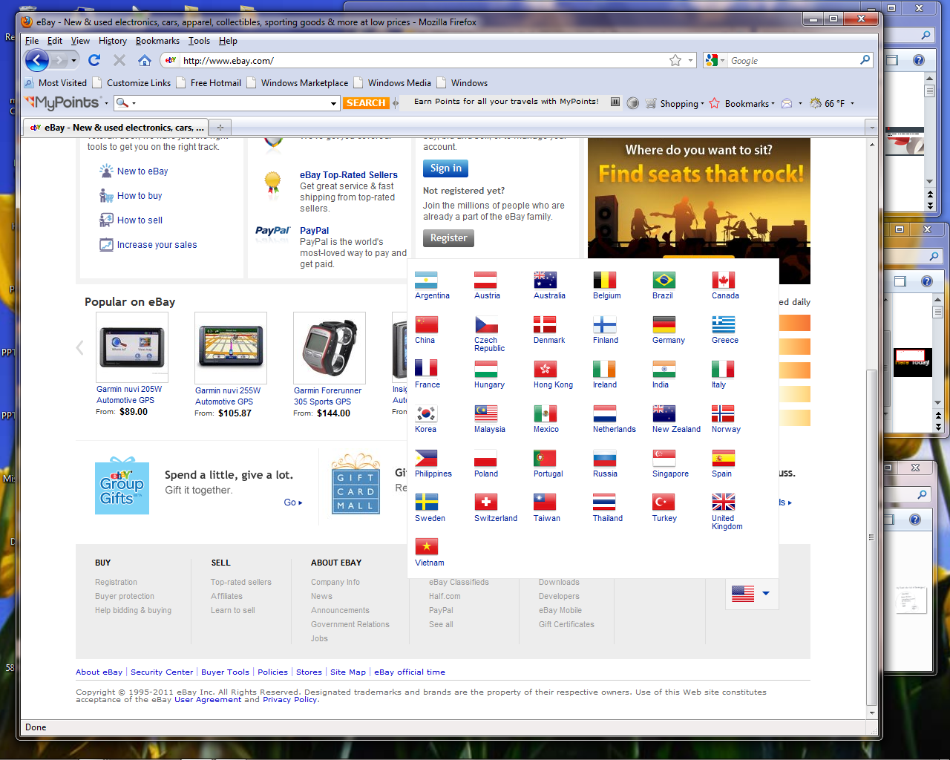











Slide 6
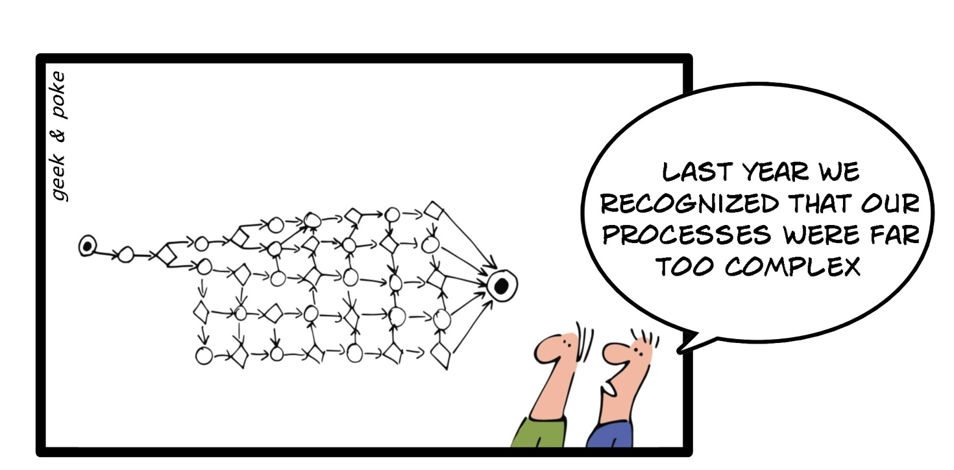
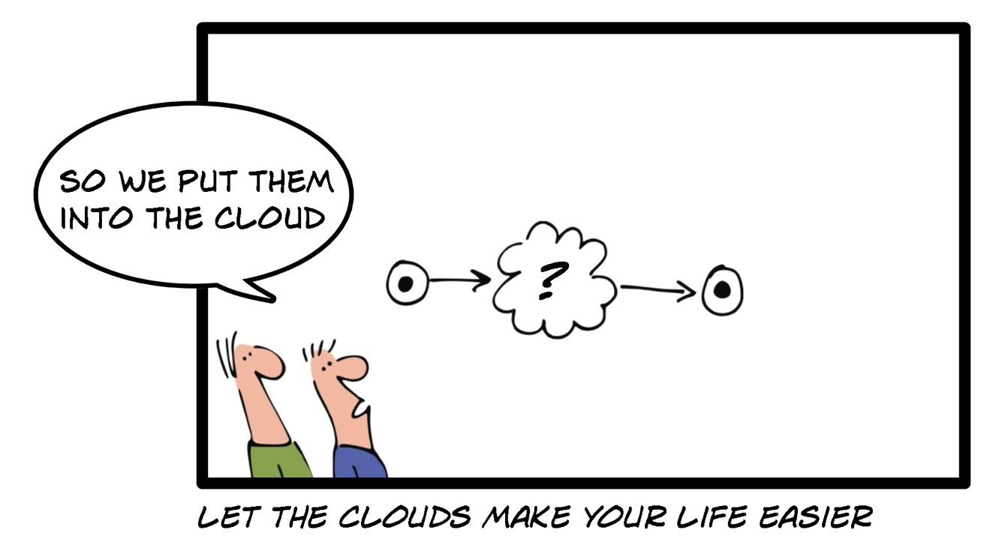

Slide 7
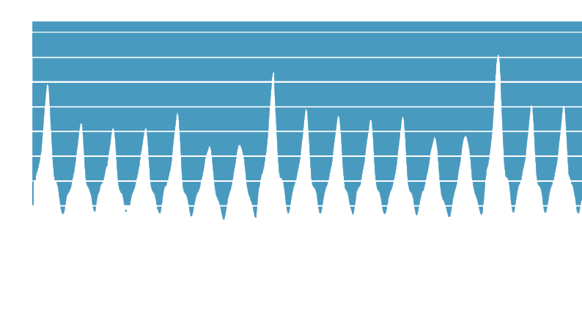
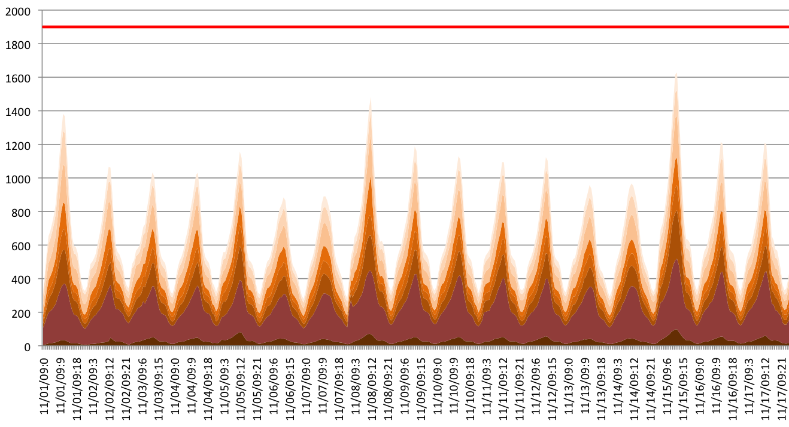
Burst to external
Cloud ?
DR
Number of servers required based on utilization for 8 pools

Slide 8
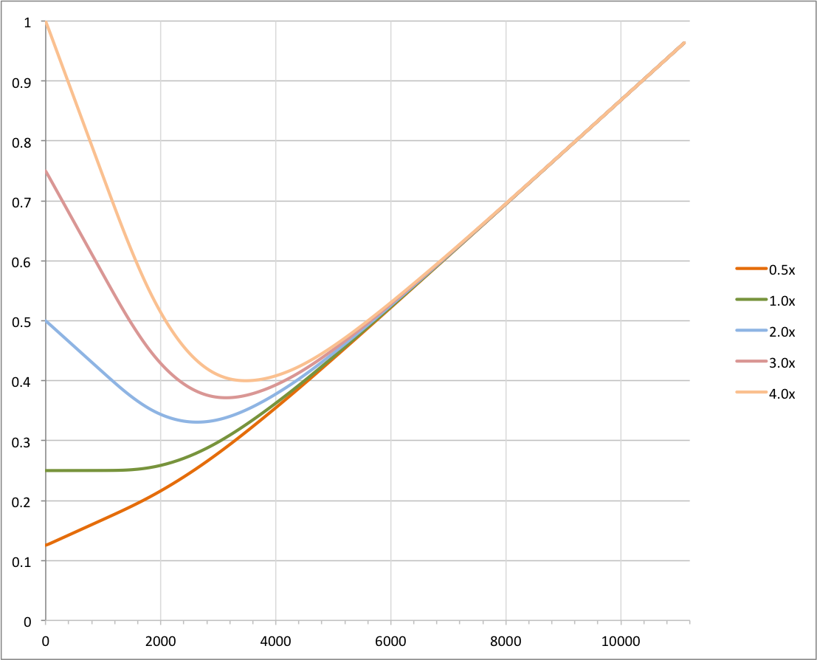
Even at 4x the internal cost, public cloud would save money
Cloud cost to
Internal cost
ratio
Cost ratio
Internal cost is dominant
External cost is dominant
Servers owned

Slide 9
?
Private
Public
Hybrid
Build
Buy
Build + OSS

Slide 10



Hybrid Cloud options
eBay DC
Public Cloud
eBay DC
Public Cloud
Ebay environment
Ebay environment
Ebay Infrastructure
Ebay Infrastructure
Virtual Data Center
Public Shared Cloud

Slide 11





Application Architecture
Before
Ongoing
“Cloud Friendly”
Future
‘Cloud ready’

Slide 12
Internal Cloud Technology stack
Service Catalog
REST APIs
Ticket driven run book automation
Model driven close loop
automation
Configuration Management
Database (CMDB)
Distributed state Management
Chargeback
Pay as you go
Server Virtualization
Multitenant infrastructure with secure isolation

Slide 13
Infrastructure virtualization
Virtual Environments
Prod
QA
Exp.
Prod
QA
Exp.
Application
App
App
App
Application
App
App
App
Spare
spare
spare
spare
Global resource pool
Infra
Infra
Infra
Infra
Shared infrastructure
Silos with custom design
Virtualized Infrastructure

Slide 14
Automate Everything
Cannot be automated
The task requires human involvement (e.g. racking and wiring)
No support for
automation
Component lacks API or requires UI based actions (e.g. checkpoint)
Limited rate of change
Configuration requires restart, reload, file sync (e.g. Bind, ISC DHCP)
No permission
Configuration requires special credential/role (e.g. firewall, network)

Slide 15





Process Simplification
request
{nb servers, model, app }
order
receive & rack & wire
Label (app)
deliver
“several”
weeks
1 w
2-3 w
repurpose
request
{nb servers, model }
order
Receive pre-racked
Pre-wired
deliver to
cache
request
{nb servers, model, app }
deliver
quarterly
45 min
1 day
2-3 w
repurpose

Slide 16
Open Source Integration
IaaS/PaaS API
IaaS/PaaS API
orchestration
Resource
Allocation
Distributed
State
orchestration
Resource
Allocation
Distributed
State
eBay
Cloud
Manager
AuthN/AuthZ
Application
Controller
Access Point
Controller
AuthN/AuthZ
Application
Controller
Access Point
Controller
Compute
Controller
Cluster
Controller
Pool
Controller
Compute
Controller
Cluster
Controller
Pool
Controller
Adopt and
Contribute
Infrastructure
Management
Services
Compute Mgt.
DNS Mgt.
LB Mgt.
Monitoring
Open Source
Solution
(openstack / Cloudstack)
Network Prov
Image/Pkg Repo
Software Dist.

